Slide 1
Synchronous Sequential Logic
Prepared By Dr. Sultan S. Alqahtani
CS106 Digital Logic

Slide 2
Content
Introduction
Sequential Circuits
Storage Elements: Latches
Storage Elements: Flip-Flops
Analysis of Clocked Sequential Circuits
State Reduction and Assignment
Design Procedure

Slide 3
Introduction
Hand-held devices, cell phones, navigation receivers, personal computers, digital cameras, personal media players, and virtually all electronic consumer products have the ability to send, receive, store, retrieve, and process information represented in a binary format.
The technology enabling and supporting these devices is critically dependent on electronic components that can store information, i.e., have memory.
This chapter examines the operation and control of these devices and their use in circuits and enables you to better understand what is happening in these devices when you interact with them.

Slide 4
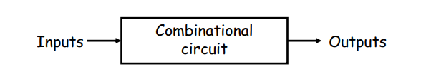
Combinational Circuits
So far we’ve just worked with combinational circuits, where applying the same inputs always produces the same outputs
This corresponds to a mathematical function, where every input has a single, unique output

Slide 5
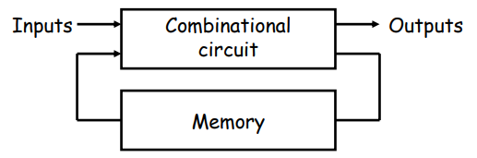
Sequential Circuits
In contrast, the outputs of a sequential circuit depend on not only the inputs, but also the state, or the current contents of some memory
This makes things more difficult to understand, since the same inputs can yield different outputs, depending on what’s stored in memory
The memory contents can also change as the circuit runs
We’ll some need new techniques for analyzing and designing sequential circuits.

Slide 6
What exactly is a memory?
A memory should have at least three properties
It should be able to hold a value.
You should be able to read the value that was saved
You should be able to change the value that’s saved
We’ll start with the simplest case, a one-bit memory
It should be able to hold a single bit, 0 or 1
You should be able to read the bit that was saved
You should be able to change the value. Since there’s only a single bit, there are only two choices:
– Set the bit to 1
– Reset, or clear, the bit to 0

Slide 7
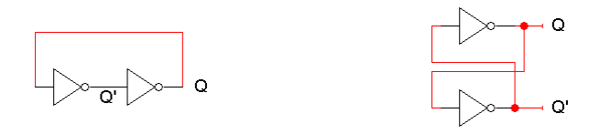
The basic idea of storage
How can a circuit “remember” anything, when it’s just a bunch of gates that produce outputs according to the inputs?
The basic idea is to make a loop, so the circuit outputs are also inputs
Here is one initial attempt, shown with two equivalent layouts:

Slide 8
The basic idea of storage
Does this satisfy the properties of memory?
– These circuits “remember” Q, because its value never changes (Similarly, Q’ never changes either.)
– We can also “read” Q, by attaching a probe or another circuit
– But we can’t change Q! There are no external inputs here, so we can’t control whether Q=1 or Q=0.

Slide 9
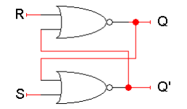
A really confusing circuit
Let’s use NOR gates instead of inverters. The SR latch below has two inputs S and R, which will let us control the outputs Q and Q’
Here Q and Q’ feed back into the circuit. They’re not only outputs, they’re also inputs!
To figure out how Q and Q’ change, we have to look at not only the inputs S and R, but also the current values of Q and Q’:
Qnext = (R + Q’current)’
Q’next = (S + Qcurrent)’
Let’s see how different input values for S and R affect this thing

Slide 10
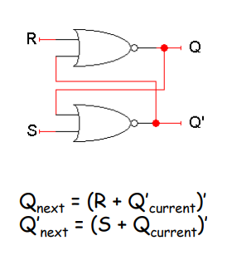
Storing a value: SR=00
What if S = 0 and R = 0?
The equations on the right reduce to:
Qnext = (0 + Q’current)’ = Qcurrent
Q’next = (0 + Qcurrent)’ = Q’current
So when SR = 00, then Qnext = Qcurrent. Whatever value Q has, it keeps
This is exactly what we need to store values in the latch.

Slide 11
Setting the latch: SR=10
What if S = 1 and R = 0?
Since S = 1, Q’next is 0, regardless of Qcurrent:
Q’next = (1 + Qcurrent)’ = 0
Then, this new value of Q’ goes into the top NOR gate, along with R = 0
Qnext = (0 + 0)’ = 1
So when SR = 10, then Q’next = 0 and Qnext = 1
This is how you set the latch to 1. The S input stands for “set”
Notice that it can take up to two steps (two gate delays) from the time S becomes 1 to the time Qnext becomes 1
But once Qnext becomes 1, the outputs will stop changing. This is a stable state

Slide 12
Resetting the latch: SR=01
What if S = 0 and R = 1?
Since R = 1, Qnext is 0, regardless of Qcurrent:
Qnext = (1 + Q’current)’ = 0
Then, this new value of Q goes into the top NOR gate, along with S = 0
Q’next = (0 + 0)’ = 1
So when SR = 01, then Qnext = 0 and Q’next = 1
This is how you reset, or clear the latch to 0. The R input stands for “reset”
Again, it can take two gate delays before a change in R propagates to the output Q’next

Slide 13
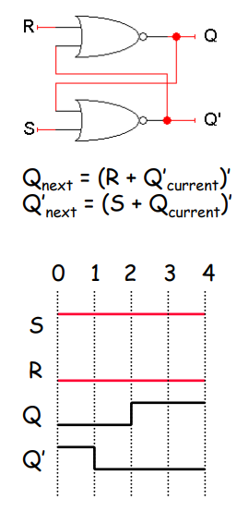
Latch delays
Timing diagrams are especially useful in understanding how sequential circuits work
Here is a diagram which shows an example of how our latch outputs change with inputs SR=10
0. Suppose that initially, Q = 0 and Q’ = 1
Since S=1, Q’ will change from 1 to 0 after one NOR-gate delay (marked by vertical lines in the diagram for clarity)
This change in Q’, along with R=0, causes Q to become 1 after another gate delay
The latch then stabilizes until S or R change again

Slide 14
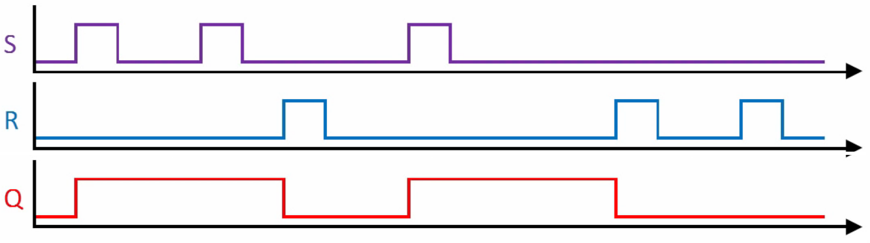

Slide 15
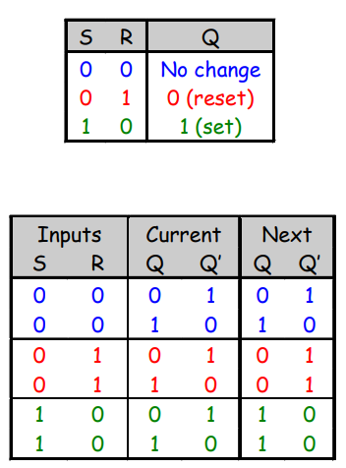
SR latches are memories!
This little table shows that our latch provides everything we need in a memory: we can set it, reset it, and remember the current value.
The output Q represents the data stored in the latch. It is sometimes called the state of the latch.
We can expand the table above into a state table, which explicitly shows that the next values of Q and Q’ depend on their current values, as well as on the inputs S and R.

Slide 16
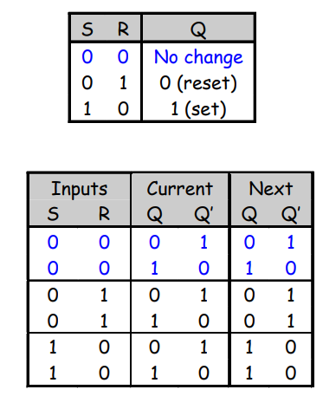
SR latches are sequential!
Notice that for inputs SR = 00, the next value of Q could be either 0 or 1, depending on the current value of Q
So the same inputs can yield different outputs, depending on whether the latch was previously set or reset
This is very different from the combinational circuits that we’ve seen so far, where the same inputs always yield the same outputs.

Slide 17
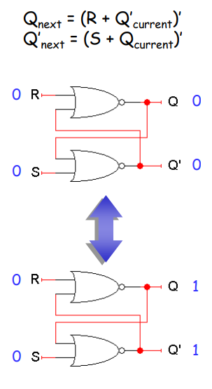
What about SR=11?
Both Qnext and Q’next will become 0
This contradicts the assumption that Q and Q’ are always complements
Another problem is what happens if we then make S = 0 and R = 0 together.
Qnext = (0 + 0)’ = 1
Q’next = (0 + 0)’ = 1
But these new values go back into the NOR gates, and in the next step we get:
Qnext = (0 + 1)’ = 0
Q’next = (0 + 1)’ = 0
The circuit enters an infinite loop, where Q and Q’ cycle between 0 and 1 forever
This is actually the worst case, but the moral is don’t ever set SR=11!

Slide 18
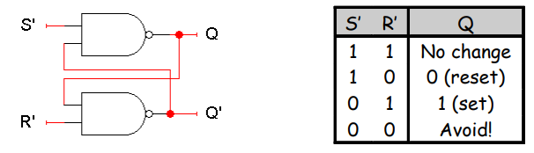
S’R’ latch
There are several varieties of latches
You can use NAND instead of NOR gates to get a S’R’ latch
This is just like an SR latch, but with inverted inputs, as you can see from the table
You can derive this table by writing equations for the outputs in terms of the inputs and the current state, just as we did for the SR latch

Slide 19
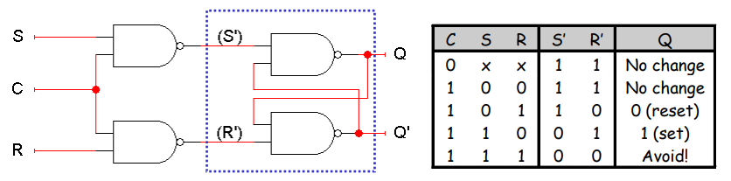
An SR latch with a control input
Here is an SR latch with a control input C
Notice the hierarchical design!
– The dotted blue box is the S’R’ latch from the previous slide
– The additional NAND gates are simply used to generate the correct inputs for the S’R’ latch
The control input acts just like an enable

Slide 20
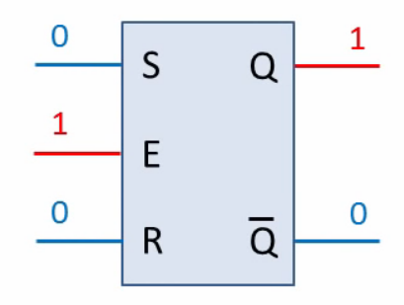
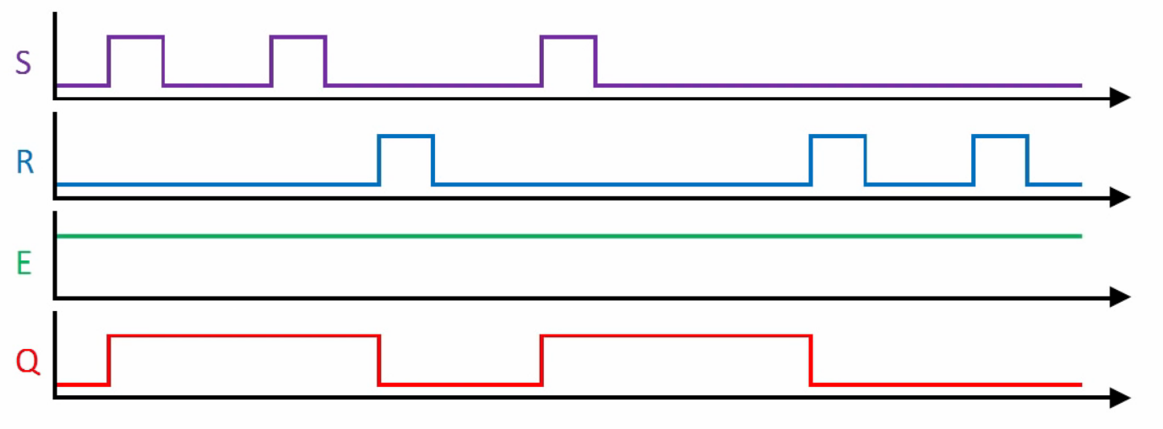

Slide 21
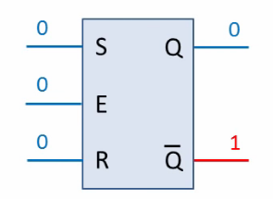
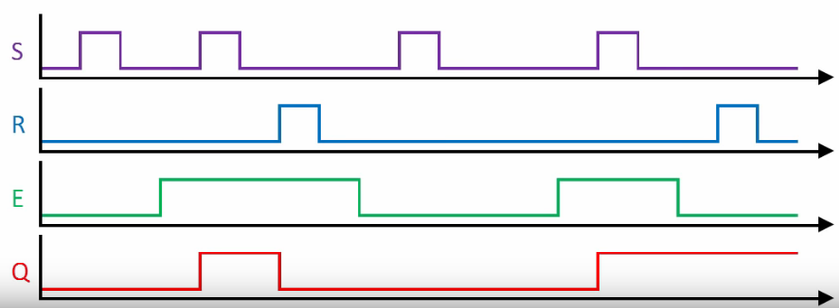

Slide 22
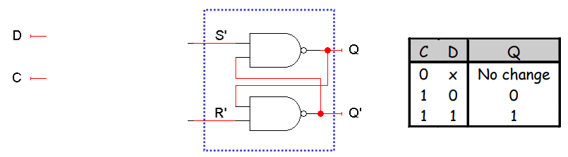
D latch
Finally, a D latch is based on an S’R’ latch. The additional gates generate the S’ and R’ signals, based on inputs D (“data”) and C (“control”)
– When C = 0, S’ and R’ are both 1, so the state Q does not change
– When C = 1, the latch output Q will equal the input D
No more messing with one input for set and another input for reset!
Also, this latch has no “bad” input combinations to avoid. Any of the four possible assignments to C and D are valid.

Slide 23
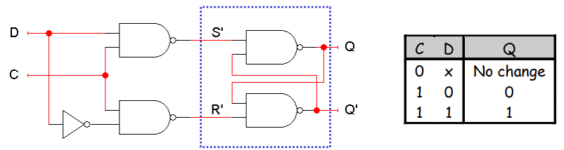
D latch
Finally, a D latch is based on an S’R’ latch. The additional gates generate the S’ and R’ signals, based on inputs D (“data”) and C (“control”)
– When C = 0, S’ and R’ are both 1, so the state Q does not change
– When C = 1, the latch output Q will equal the input D
No more messing with one input for set and another input for reset!
Also, this latch has no “bad” input combinations to avoid. Any of the four possible assignments to C and D are valid.

Slide 24
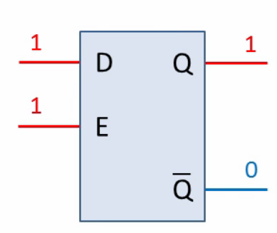
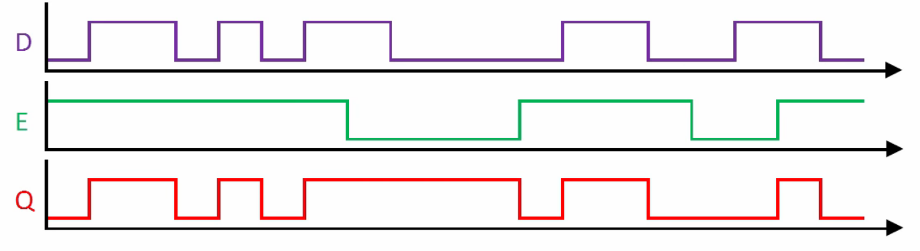

Slide 25
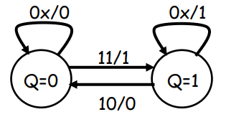
Sequential circuits and state diagrams
To describe combinational circuits, we used Boolean expressions and truth tables. With sequential circuits, we can still use expression and tables, but we can also use another form called a state diagram
We draw one node for each state that the circuit can be in. Latches have only two states: Q=0 and Q=1
Arrows between nodes are labeled with “input/output” and indicate how the circuit changes states and what its outputs are. In this case the state and the output are the same
Here’s a state diagram for a D latch with inputs D and C

Slide 26
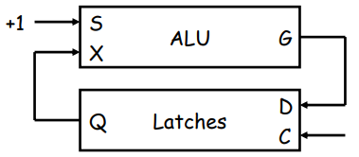
Using latches in real life
We can connect some latches, acting as memory, to an ALU
Let’s say these latches contain some value that we want to increment
– The ALU should read the current latch value
– It applies the “G = X + 1” operation
– The incremented value is stored back into the latches
At this point, we have to stop the cycle, so the latch value doesn’t get incremented again by accident
One convenient way to break the loop is to disable the latches

Slide 27
The problem with latches
The problem is exactly when to disable the latches. You have to wait long enough for the ALU to produce its output, but no longer
– But different ALU operations have different delays. For instance, arithmetic operations might go through an adder, whereas logical operations don’t
– Changing the ALU implementation, such as using a carry-lookahead adder instead of a ripple-carry adder, also affects the delay
In general, it’s very difficult to know how long operations take, and how long latches should be enabled for

Slide 28
Summary
A sequential circuit has memory. It may respond differently to the same inputs, depending on its current state
Memories can be created by making circuits with feedback
– Latches are the simplest memory units, storing individual bits
– It’s difficult to control the timing of latches in a larger circuit
Next, we’ll improve upon latches with flip-flops, which change state only at well-defined times. We will then use flip-flops to build all of our sequential circuits.

Slide 29
Flip-Flops
Last time, we saw how latches can be used as memory in a circuit
Latches introduce new problems:
– We need to know when to enable a latch
– We also need to quickly disable a latch
– In other words, it’s difficult to control the timing of latches in a large circuit
We solve these problems with two new elements: clocks and flip-flops
– Clocks tell us when to write to our memory
– Flip-flops allow us to quickly write the memory at clearly defined times
– Used together, we can create circuits without worrying about the memory timing

Slide 30
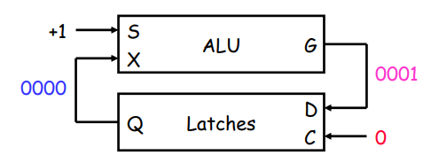
Making latches work right
Our example used latches as memory for an ALU
– Let’s say there are four latches initially storing 0000
– We want to use an ALU to increment that value to 0001
Normally the latches should be disabled, to prevent unwanted data from being accidentally stored
– In our example, the ALU can read the current latch contents, 0000, and compute their increment, 0001
– But the new value cannot be stored back while the latch is disabled

Slide 31
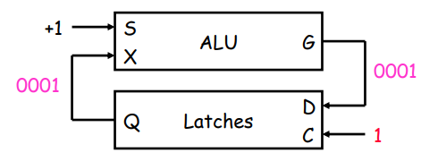
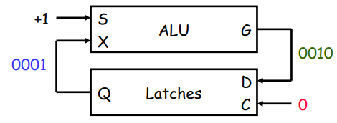
Writing to the latches
After the ALU has finished its increment operation, the latch can be enabled, and the updated value is stored.
The latch must be quickly disabled again, before the ALU has a chance to read the new value 0001 and produce a new result 0010.

Slide 32
Two main issues
So to use latches correctly within a circuit, we have to:
– Keep the latches disabled until new values are ready to be stored
– Enable the latches just long enough for the update to occur
There are two main issues we need to address:
How do we know exactly when the new values are ready?
We’ll add another signal to our circuit. When this new signal becomes 1, the latches will know that the ALU computation has completed and data is ready to be stored
How can we enable and then quickly disable the latches?
This can be done by combining latches together in a special way, to form what are called flip-flops

Slide 33
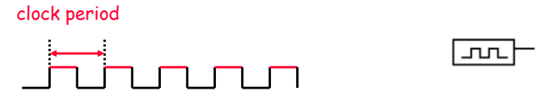
Clocks and synchronization
A clock is a special device whose output continuously alternates between 0 and 1.
The time it takes the clock to change from 1 to 0 and back to 1 is called the clock period, or clock cycle time
The clock frequency is the inverse of the clock period. The unit of measurement for frequency is the hertz

Slide 34
Clocks and synchronization
Clocks are often used to synchronize circuits
– They generate a repeating, predictable pattern of 0s and 1s that can trigger certain events in a circuit, such as writing to a latch
– If several circuits share a common clock signal, they can coordinate their actions with respect to one another
This is similar to how humans use real clocks for synchronization.

Slide 35
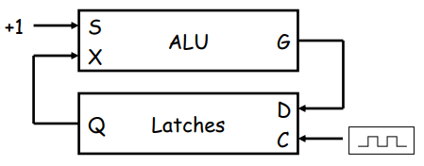
Synchronizing our example
We can use a clock to synchronize our latches with the ALU
– The clock signal is connected to the latch control input C
– The clock controls the latches. When it becomes 1, the latches will be enabled for writing
The clock period must be set appropriately for the ALU
– It should not be too short. Otherwise, the latches will start writing before the ALU operation has finished
– The faster the ALU runs, the shorter the clock period can be
– But in the current design, if the clock period is too large, it’s a problem too..

Slide 36
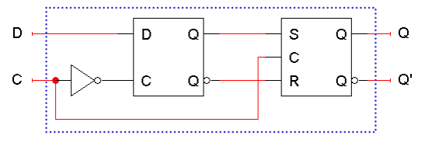
Flip-flops
The second issue was how to enable a latch for just an instant
Here is the internal structure of a D flip-flop
– The flip-flop inputs are C and D, and the outputs are Q and Q’
– The D latch on the left is the master, while the SR latch on the right is called the slave
Note the layout here
– The flip-flop input D is connected directly to the master latch
– The master latch output goes to the slave
– The flip-flop outputs come directly from the slave latch

Slide 37
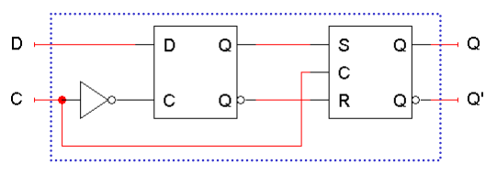
D flip-flops when C=0
The D flip-flop’s control input C enables either the D latch or the SR latch, but not both
When C = 0:
– The master latch is enabled, and it monitors the flip-flop input D. Whenever D changes, the master’s output changes too
– The slave is disabled, so the D latch output has no effect on it. Thus, the slave just maintains the flip-flop’s current state

Slide 38
D flip-flops when C=1
As soon as C becomes 1, (i.e. on the rising edge of the clock)
– The master is disabled. Its output will be the last D input value seen just before C became 1
– Any subsequent changes to the D input while C = 1 have no effect on the master latch, which is now disabled
– The slave latch is enabled. Its state changes to reflect the master’s output, which again is the D input value from right when C became 1

Slide 39
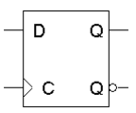
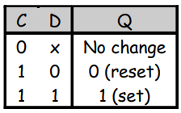
Positive edge triggering
This is called a positive edge-triggered flip-flop
– The flip-flop output Q changes only after the positive edge of C
– The change is based on the flip-flop input values that were present right at the positive edge of the clock signal •
The D flip-flop’s behavior is similar to that of a D latch except for the positive edge-triggered nature, which is not explicit in this table

Slide 40
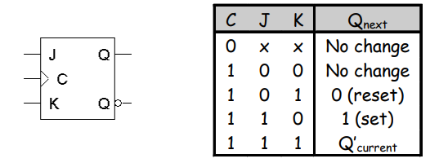
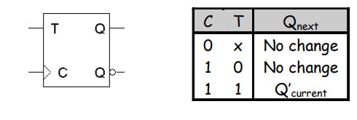
Flip-flop variations
We can make different versions of flip-flops based on the D flip-flop, just like we made different latches based on the S’R’ latch
A JK flip-flop has inputs that act like S and R, but the inputs JK=11 are used to complement the flip-flop’s current state
A T flip-flop can only maintain or complement its current state.

Slide 41
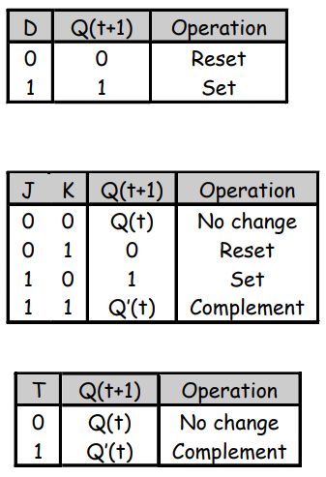
Characteristic tables
The tables that we’ve made so far are called characteristic tables
– They show the next state Q(t+1) in terms of the current state Q(t) and the inputs
– For simplicity, the control input C is not usually listed.
– Again, these tables don’t indicate the positive edge-triggered behavior of the flip-flops that we’ll be using.

Slide 42
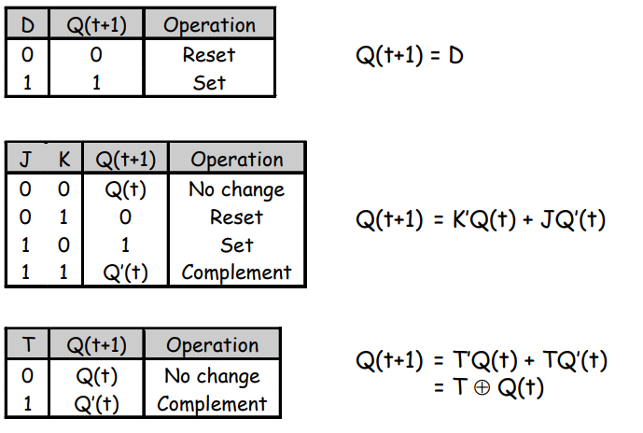
Characteristic tables
We can also write characteristic equations, where the next state Q(t+1) is defined in terms of the current state Q(t) and inputs

Slide 43
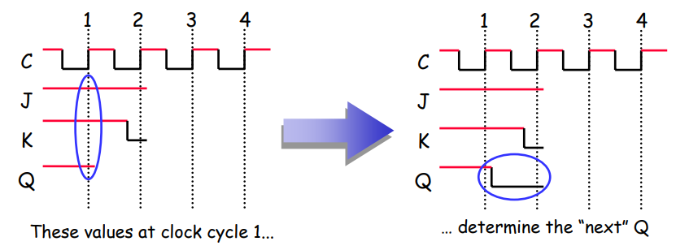
Flip flop timing diagrams
“Present state” and “next state” are relative terms
In the example JK flip-flop timing diagram on the left, you can see that at the first positive clock edge, J=1, K=1 and Q(1) = 1
We can use this information to find the “next” state, Q(2) = Q(1)’
Q(2) appears right after the first positive clock edge, as shown on the right. It will not change again until after the second clock edge

Slide 44
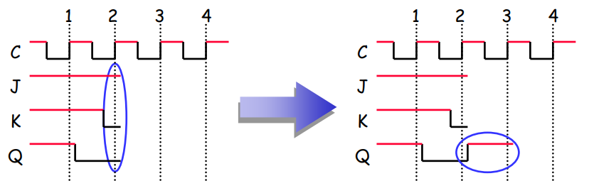
“Present” and “next” are relative
Similarly, the values of J, K and Q at the second positive clock edge can be used to find the value of Q during the third clock cycle
When we do this, Q(2) is now referred to as the “present” state, and Q(3) is now the “next” state

Slide 45
Summary
To use memory in a larger circuit, we need to:
– Keep the latches disabled until new values are ready to be stored
– Enable the latches just long enough for the update to occur
A clock signal is used to synchronize circuits. The cycle time reflects how long combinational operations take
Flip-flops further restrict the memory writing interval, to just the positive edge of the clock signal
– This ensures that memory is updated only once per clock cycle
– There are several different kinds of flip-flops, but they all serve the same basic purpose of storing bits
Next week we’ll talk about how to analyze and design sequential circuits that use flip-flops as memory

Slide 46
Sequential Circuit Analysis

Slide 47
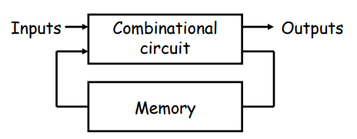
Mealy or Moore???
The output of a sequential circuit can be expressed in two different ways:
– Moore model: Outputs= f(present state)
– Mealy model: Outputs: f(present state, inputs)

Slide 48
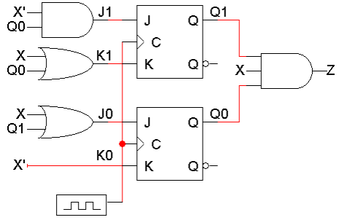
An example sequential circuit
A sequential circuit with two JK flip-flops
State or memory: Q1Q0
One input: X; One output: Z

Slide 49
How do you describe a sequential circuit?
A combinational circuit - Truth table, which shows how the outputs are related to the inputs
A sequential circuit - State table, which shows inputs and current states on the left, and outputs and next states on the right
– Need to find the next state of the FFs based on the present state and inputs
– Need to find the output of the circuit as a function of > current state for a circuit of the Moore model > current state and inputs for a circuit of the Mealy model

Slide 50
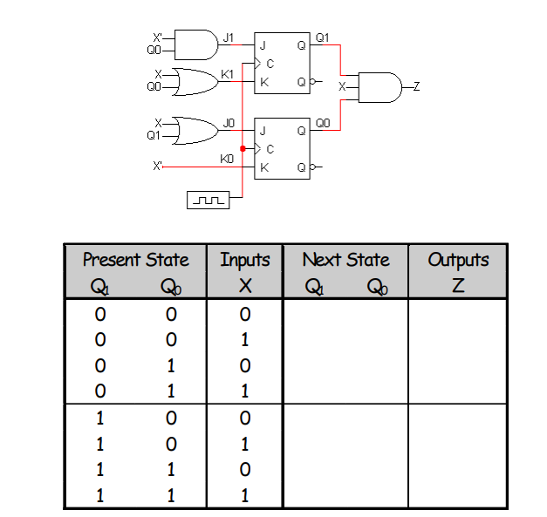
State table of example circuit

Slide 51
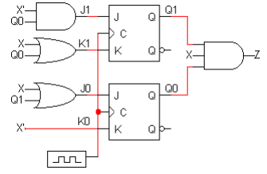
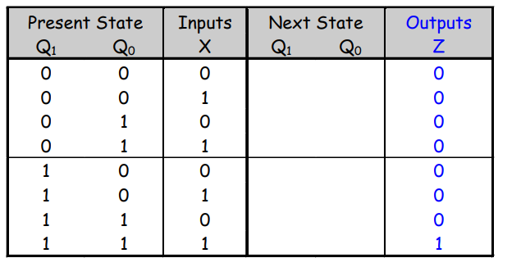
The outputs are easy
From the diagram, you can see that
Z = Q1Q 0 X
Mealy model circuit !!!

Slide 52
Flip-flop input equations
Finding the next states is harder
Step 1: Find Boolean expressions for the flip-flop inputs i.e., How do the inputs (say, J & K) to the flip-flops depend on the current state and input
Step 2: Use these expressions to find the actual flip-flop input values for each possible combination of present states and inputs i.e., Fill in the state table (with new intermediate columns)
Step 3: Use flip-flop characteristic tables or equations to find the next states, based on the flip-flop input values and the present states

Slide 53
Step 1: Flip-flop input equations
For our example, the flip-flop input equations are:
J1 = X’ Q0
K1 = X + Q0
J0 = X + Q1
K0 = X’

Slide 54
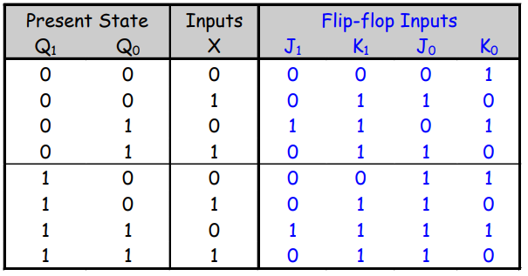
Step 2: Flip-flop input values
With these equations, we can make a table showing J1, K1, J0 and K0 for the different combinations of present state Q1Q0 and input X
J1 = X’ Q0 J0 = X + Q1
K1 = X + Q0 K0 = X’

Slide 55
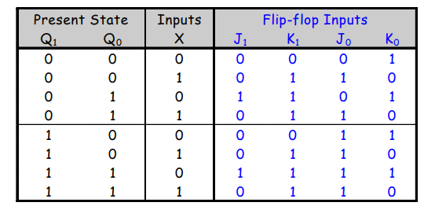
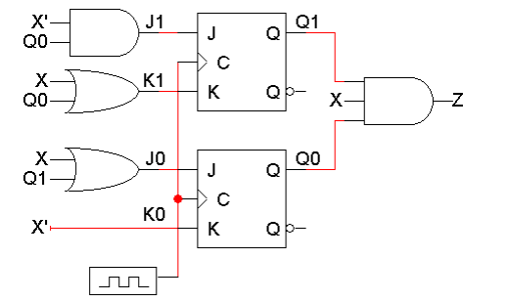
Step 2: Flip-flop input values

Slide 56
Step 3: Find the next states
Finally, use the JK flip-flop characteristic tables or equations to find the next state of each flip-flop, based on its present state and inputs
The general JK flip-flop characteristic equation is:
Q(t+1) = K’Q(t) + JQ’(t)
In our example circuit, we have two JK flip-flops, so we have to apply this equation to each of them:
Q1(t+1) = K1’Q1(t) + J1Q1’(t)
Q0(t+1) = K0’Q0(t) + J0 Q0’(t)
We can also determine the next state for each input/current state combination directly from the characteristic table

Slide 57
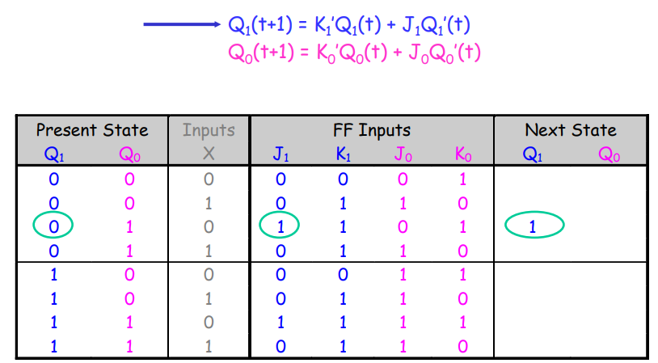
Step 3 concluded
The next states for Q1 and Q0, are calculated using these equations:

Slide 58
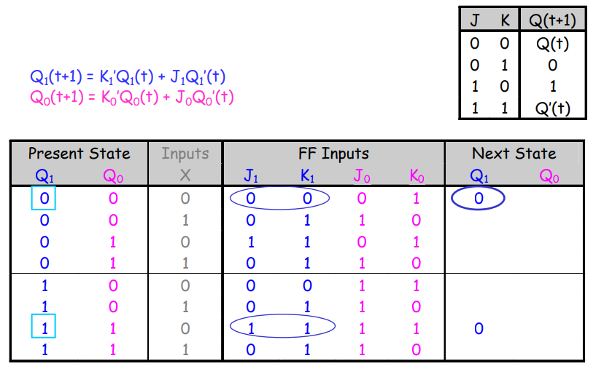
Step 3 concluded
Using the characteristic equations Or the characteristic table.

Slide 59
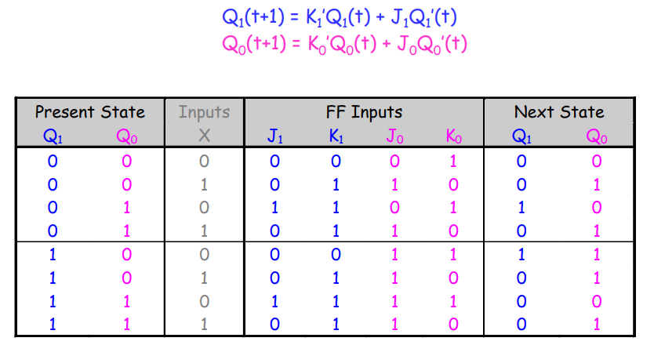
Step 3 concluded
Finally, here are the next states for Q1 and Q0, using these equations:

Slide 60
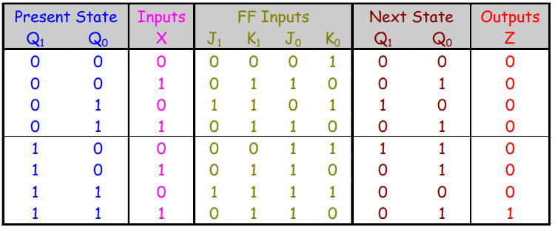
Getting the state table columns straight
The table starts with Present State and Inputs
– Present State and Inputs yield FF Inputs
– Present State and FF Inputs yield Next State, based on the flip-flop characteristic tables
– Present State and Inputs yield Output

Slide 61
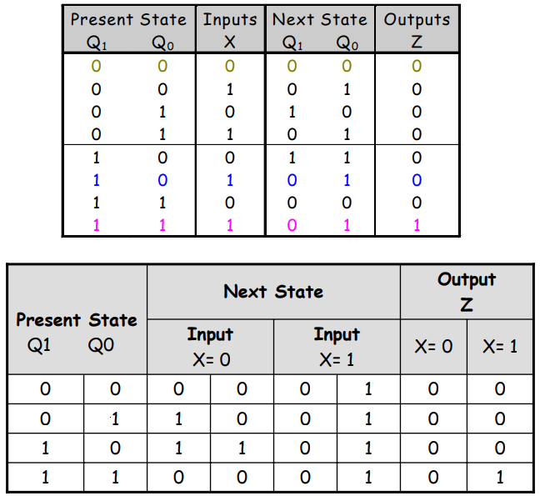
A different look

Slide 62

State diagrams (Mealy model)
We can also represent the state table graphically with a state diagram
A diagram corresponding to our example state table is shown below

Slide 63


Sizes of state diagrams
Always check the size of your state diagrams
– If there are n flip-flops, there should be $2^{n}$ nodes in the diagram
– If there are m inputs, then each node will have $2^{m}$ outgoing arrows
In our example,
– We have two flip-flops, and thus four states or nodes.
– There is one input, so each node has two outgoing arrows.

Slide 64

Moore type circuit
H.W ☹
Two inputs: X and Y; One output: Z
One state: A
Note that Z= A, just a function of the current state

Slide 65
Sequential circuit design

Slide 66

Sequential circuit design
In sequential circuit design, we turn some description into a working circuit
– We first make a state table or diagram to express the computation – Then we can turn that table or diagram into a sequential circuit

Slide 67
Sequential circuit design procedure
Step 1:
Make a state table based on the problem statement. The table should show the present states, inputs, next states and outputs. (It may be easier to find a state diagram first, and then convert that to a table)
Step 2:
Assign binary codes to the states in the state table, if you haven’t already.
Step 3:
For each flip-flop and each row of your state table, find the flip-flop input values that are needed to generate the next state from the present state. You can use flip-flop excitation tables here.
Step 4:
Find simplified equations for the flip-flop inputs and the outputs.
Step 5:
Build the circuit!

Slide 68

Sequence recognizers
A sequence recognizer is a special kind of sequential circuit that looks for a special bit pattern in some input
The recognizer circuit has only one input, X
– One bit of input is supplied on every clock cycle
– This is an easy way to permit arbitrarily long input sequences
There is one output, Z, which is 1 when the desired pattern is found
Our example will detect the bit pattern “1001”:
A sequential circuit is required because the circuit has to “remember” the inputs from previous clock cycles, in order to determine whether or not a match was found

Slide 69
Step 1: Making a state table
The first thing you have to figure out is precisely how the use of state will help you solve the given problem
– Make a state table based on the problem statement. The table should show the present states, inputs, next states and outputs
– Sometimes it is easier to first find a state diagram and then convert that to a table
This is usually the most difficult step. Once you have the state table, the rest of the design procedure is the same for all sequential circuits

Slide 70

A basic state diagram
What state do we need for the sequence recognizer?
– We have to “remember” inputs from previous clock cycles
– For example, if the previous three inputs were 100 and the current input is 1, then the output should be 1
– In general, we will have to remember occurrences of parts of the desired pattern—in this case, 1, 10, and 100
We’ll start with a basic state diagram:

Slide 71

Overlapping occurrences of the pattern
What happens if we’re in state D (the last three inputs were 100), and the current input is 1?
– The output should be a 1, because we’ve found the desired pattern
– But this last 1 could also be the start of another occurrence of the pattern! For example, 1001001 contains two occurrences of 1001
– To detect overlapping occurrences of the pattern, the next state should be B.

Slide 72

Filling in the other arrows
Two outgoing arrows for each node, to account for the possibilities of X=0 and X=1
The remaining arrows we need are shown in blue. They also allow for the correct detection of overlapping occurrences of 1001.

Slide 73



Finally, making the state table
Remember how the state diagram arrows correspond to rows of the state table:

Slide 74

Step 2: Assigning binary codes to states
We have four states ABCD, so we need at least two flip-flops Q1Q0
The easiest thing to do is represent state A with Q1Q0 = 00, B with 01, C with 10, and D with 11
The state assignment can have a big impact on circuit complexity, but we won’t worry about that too much in this class

Slide 75

Finding flip-flop input values
Next we have to figure out how to actually make the flip-flops change from their present state into the desired next state
This depends on what kind of flip-flops you use!
We’ll use two JKs. For each flip-flip Qi, look at its present and next states, and determine what the inputs Ji and Ki should be in order to make that state change.

Slide 76

Finding JK flip-flop input values
For JK flip-flops, this is a little tricky. Recall the characteristic table:
If the present state of a JK flip-flop is 0 and we want the next state to be 1, then we have two choices for the JK inputs:
– We can use JK= 10, to explicitly set the flip-flop’s next state to 1
– We can also use JK=11, to complement the current state 0
So to change from 0 to 1, we must set J=1, but K could be either 0 or 1
Similarly, the other possible state transitions can all be done in two different ways as well

Slide 77



Slide 78


JK excitation table
An excitation table shows what flip-flop inputs are required in order to make a desired state change
This is the same information that’s given in the characteristic table, but presented “backwards”

Slide 79


Back to the example
Use the JK excitation table on the right to find the correct values for each flip-flop’s inputs, based on its present and next states

Slide 80

Step 4: Find equations for the FF inputs and output
Now you can make K-maps and find equations for each of the four flip-flop inputs, as well as for the output Z
These equations are in terms of the present state and the inputs
The advantage of using JK flip-flops is that there are many don’t care conditions, which can result in simpler MSP equations
Use K-map

Slide 81

Step 5: Build the circuit
Lastly, we use these simplified equations to build the completed circuit

Slide 82

Timing diagram
Here is one example timing diagram for our sequence detector
– The flip-flops Q1Q0 start in the initial state, 00
– On the first three positive clock edges, X is 1, 0, and 0. These inputs cause Q1Q0 to change, so after the third edge Q1Q0 = 11
– Then when X=1, Z becomes 1 also, meaning that 1001 was found
The output Z does not have to change at positive clock edges. Instead, it may change whenever X changes, since Z = Q1Q0X

Slide 83
Summary
The basic sequential circuit design procedure:
– Make a state table and, if desired, a state diagram. This step is usually the hardest
– Assign binary codes to the states if you didn’t already
– Use the present states, next states, and flip-flop excitation tables to find the flip-flop input values
– Write simplified equations for the flip-flop inputs and outputs and build the circuit

